Slide 1
Connect
Connecting Australian businesses with experienced, trusted and networked trade consultants to successfully set up cross-boarder

Slide 2
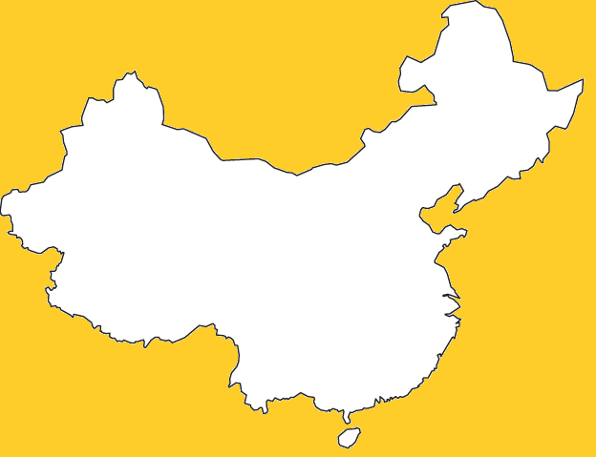
The opportunity size is significant
18.3%
Of the world’s population live in China spending over $1.5T in 2015 and fore4.3T casted spend of $by 2020¹
15%
18%
15%
Of the world GDP is derived from China with further growth predicted
Top 3 exporters to China:
South Korean
Japan
Taiwan
4.2%
4.2%
Of China’s imports are from Australia
Notes:
There is a clearly significant opportunity in the Chinese market
Yet only 4.2% of Chinese imports are goods from Australia

Slide 3




Australian businesses are limited by the knowledge gap due to clear market differences in different aspects of the value chain
Knowledge required in different components
Successful companies have attributed their success to China export consultants
“In China you can get a lot of enquiries from people wanting to do business with you,’ says Hoddle. ‘It is important to choose a partner who is already strong in the market, with distribution networks in place”
“Having our own translator was an invaluable resource, helping us to understand the mood of the conversation and ensuring we were able to convey our preferences without offending anyone.”
Continuing clear need for access to expertise
“We are looking to partner with Chinese internet sales platforms and logistics companies to develop more direct trade routes”
“Our biggest challenges, particularly in China, have been finding the right supply chain partners”
Notes:
Why can’t we capitalise on this better, particularly when there are already great e-commerce platorms for businesses to leverage
Knowledge gap across different components of the value chain when exporting to China
Successful businesses have attributed their success to having on the ground experts in China
Other businesses are clearly calling out a need to tap into these types of resources

Slide 4
Notes:
So how we will help provide a solution to this for small businesses, like Xavier
Xavier owns a small businesses selling Manuka honey, based out of Victoria
Xavier banks with NAB and is interested in selling in selling excess honey out to China but simply does not know how to start
What Connect will do is provide a P2P service to connect Xavier to expert consultants, dynamically suggesting consultants based on customer information from NAB APIs and additional information captured through an AI driven chat bot
I’ll pass on to Xavier to show you his experience

Slide 5
Color 1- Plum (Red- 184, Green- 13, Blue- 72)
Color 2- Orange (Red- 242, Green- 151, Blue- 36)
Color 3- Dark Teal (Red- 43, Green- 106, Blue- 108)
Color 4- Dark Grey (Red- 64, Green- 64, Blue- 64
References: 4.2% https://dfat.gov.au/trade/resources/Documents/chin.pdf

Slide 6
Connect

